Slide 1
GP5-900A00-26V-964 for RGM SPACE
LVT IV Vibration failure analysis
13/02/2024

Slide 2
LOT VALIDATION details
Customer | RGM SPACE
Customer Purchase Order | RSP20-0000391
SCC Component Number | 36010030126V1
LEACH Part Number | GP5-900A00-26V-964
Date-code | 23-16B

Slide 3
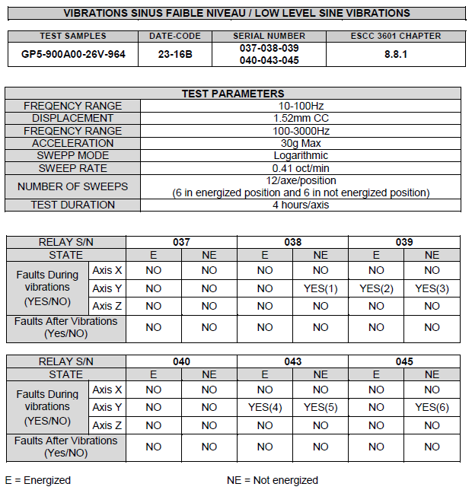
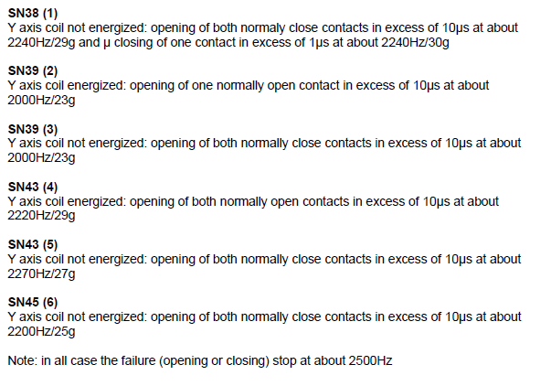
Failure detected during LVT

Slide 4
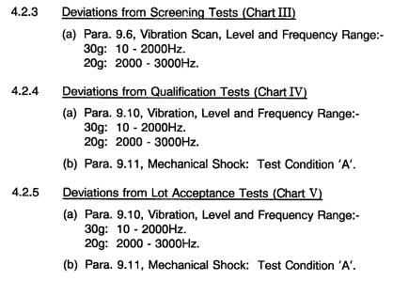
Background
As per ESCC Detail Specification No. 3601/003 issue 4, August 2005, vibration test condition was :
Original Generic specification requested :
- 30g at 100-2000 Hz
- 20g at 2000-3000 Hz
It was specified that relay was to be less stress during 2000-3000 Hz frequency
That was done on purpose

Slide 5
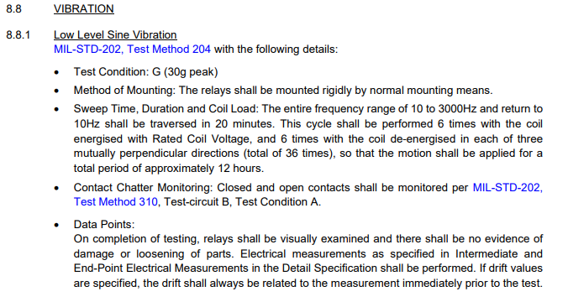

Background
As per ESCC Detail Specification No. 3601/003 issue 5, December 2013, vibration test condition is :
Extract of Generic ESCC 3601
Same level during 10-3000 Hz frequency range

Slide 6
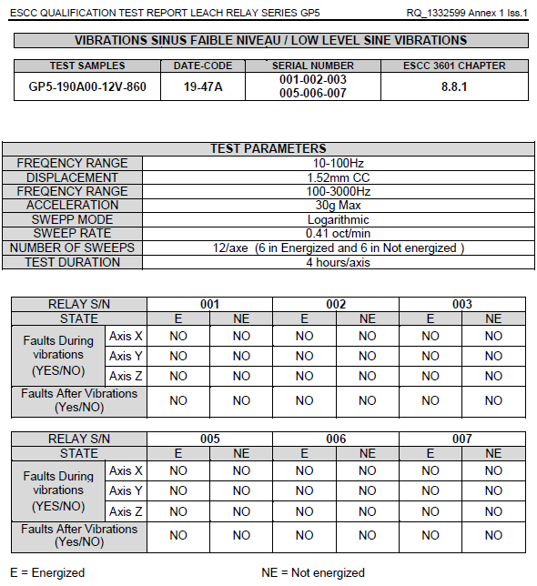
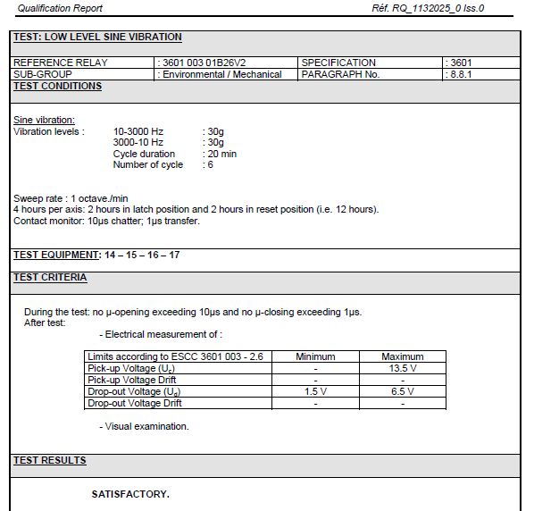
Background
During 2013 and 2019 MOQ, Leach applied new specification : test was PASS

Slide 7
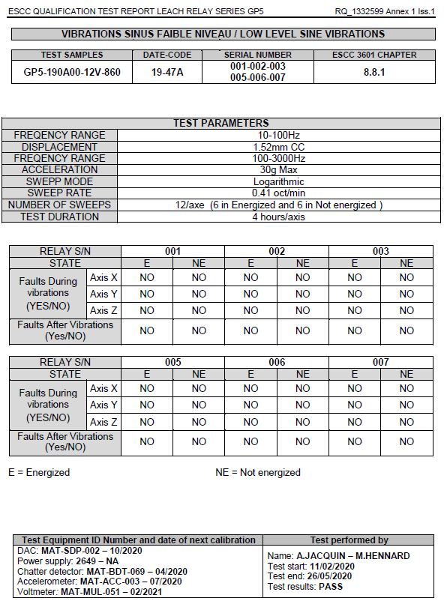
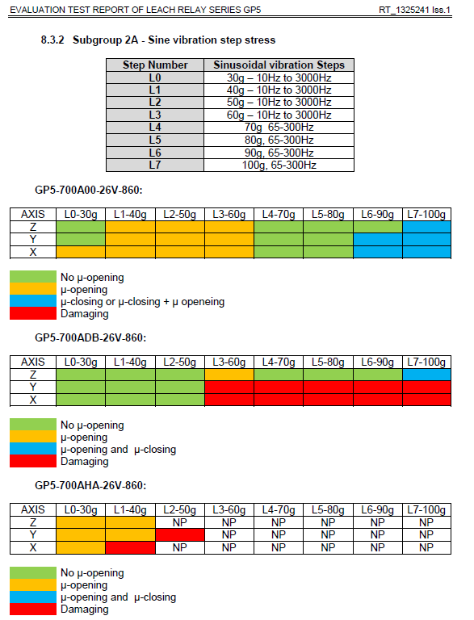
Background
During 2022 Evaluation, Leach detected Fail at 30g, while 2022 qualification test Passed

Slide 8
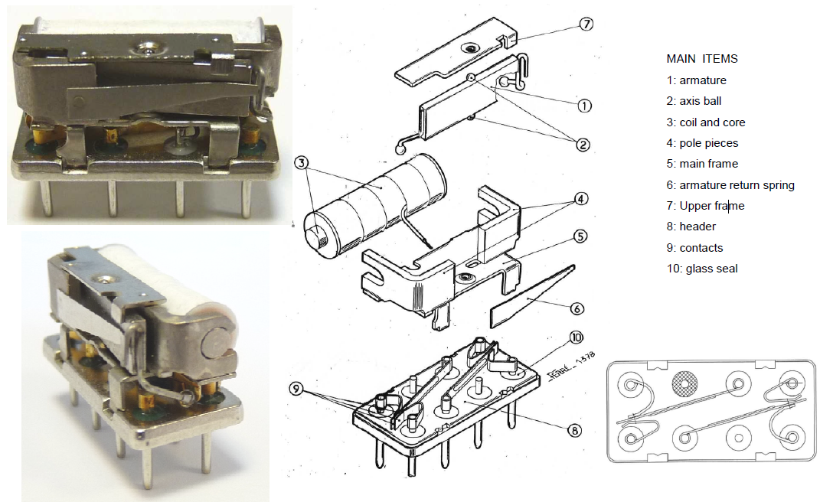
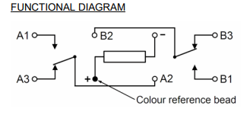
GP5 internal assembly

Slide 9
Vibration failure analysis
Above is the record performed on relays S/N 37 & 38
We can see that frequency between 2000 to 3000 Hz is the more demanding for the relays
This is impacting the moving part of the relays, and especially the moving blade
Due to the resonant frequency of the moving blade, the contact point is moving and generate micro openings

Slide 10
Conclusion
Initial Detail specification was requested to test relays at 20g between 2000-3000 Hz frequency
During Detail specification update, this deviation has been removed.
Since that, Leach as tested successfully to the new specification, but also pointed susceptibility during 2022 evaluation.
Due to the resonant frequency of the moving blade, the contact point is moving and generate micro openings between 2000-3000 Hz frequency vibration at 30g,
Leach consider this is link to the original design characteristic of the relay.
It is also supported as 2 of the 6 units under test were passed

