Slide 1
PRECISION AND POWER RESISTORS
DCR ESCC 4001/027 Issue 6
Sreening: Change of overload parameters/Burn-In
Issue Date: Juni 2022

Slide 2
Contents
1. Problem description
2. Root cause
3. Error distribution related to type and resistance material
4. Comparison of measurements
5. Summary of specification changes

Slide 3
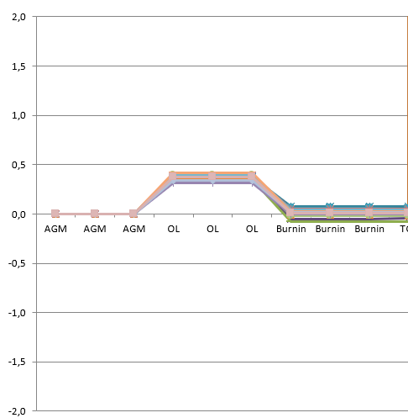
DCR ESCC 4001/027 Issue 6
1. Problem description
Specification violation during Screening Chart F3
Specification violations occur during the Overlaod and Burn-In tests and show some correlation. While the resistance drift during the Overload (tolerance ±0.3%) is in the positive range, the Burn-In's drift (tolerance ±0.2%) is almost to the same extent in the negative range. A correlation between resistance values or layout could not be proven.
Example (SMT-R560-1.0):
Overload
Burn-In

Slide 4
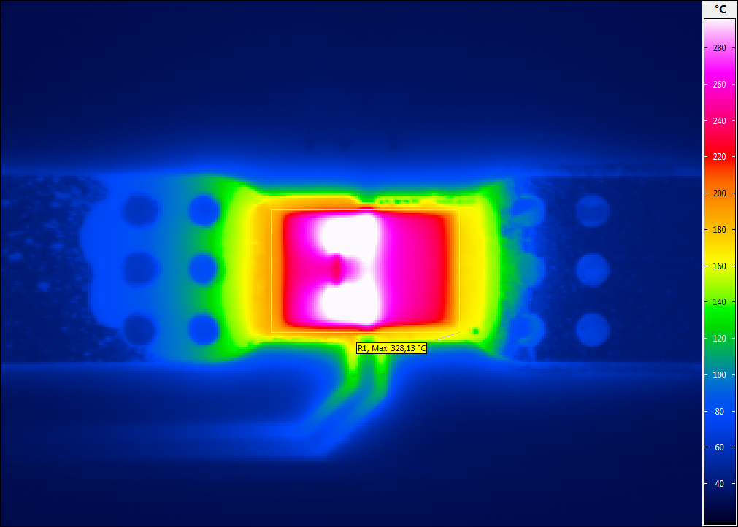
2. Root cause
DCR ESCC 4001/027 Issue 6
With the overload test (Voltage: √(5Pn x Rn); Duration: 5s), the resistor is subjected to a thermal load which leads to distortion of the resistor foil.
Measurements with an IR camera showed temperatures up to approx. 330°C. The max. permissible application temperature for these resistors is 170°C.
During the subsequent burn-in at 170°C/168h a relaxation of the resistor foil takes place, which explains the decrease of the resistor drift.
Failed part

Slide 5
DCR ESCC 4001/027 Issue 6
3. Error distribution related to type and resistance material
Type | Resistance material
 | Manganin® |  | Zeranin®30 |  | Results
Resistance value | failed | passed | failed | passed
SMP |  | 24 | 1 | 7 | 32
SMS | 12 | 15 | 11 | 8 | 46
SMT | 28 | 10 | 36 | 7 | 81
Results | 40 | 49 | 48 | 22 | 159
It can be seen that the failure rate increases strongly from SMP to SMS/SMT.
This is related to the load/surface distribution, which has a direct influence on the heat distribution (see test curves on the following pages). A correlation between resistance material/value and frequency cannot be seen.
Type | Length (mm) | Width (mm) | Surface (mm^2) | Load (W) | Mulitple nominal load (current) | Surface load (mm^2/W) | Multiple nominal load (optimized) | Surface load (mm^2/W)
SMT | 5,90 | 3,40 | 20,06 | 3,00 | 5 | 1,34 | 3,5 | 1,91
SMS | 5,50 | 2,50 | 13,75 | 2,00 | 5 | 1,38 | 3,5 | 1,96
SMP | 4,16 | 2,29 | 9,53 | 1,00 | 5 | 1,91 | 5 | 1,91
By adjusting the multiplication of the load for types SMS and SMT, the area load is reduced to the level of SMP. In this context, a change of the tolerance for the Burn-In/Operating Life Test is not necessary.

Slide 6
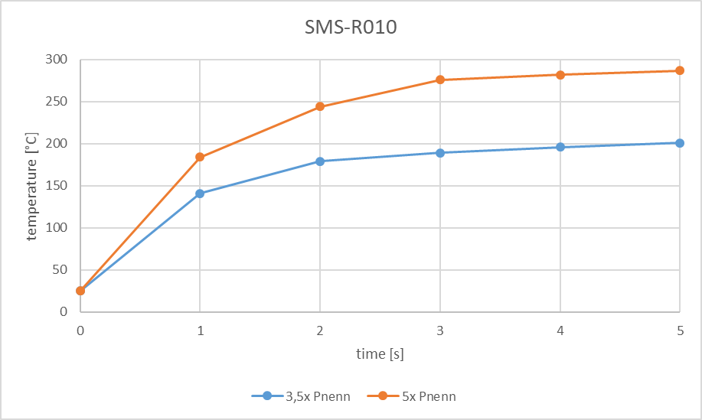
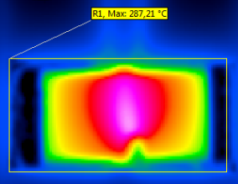
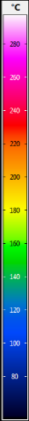
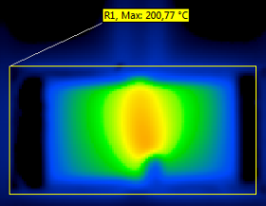
Temperature development over time - Overload compare 3,5x vs. 5x P_{nenn}
Space Testing
Mitbewerber
IR-picture after 5s at 5x P_{nenn}
∆T after 5s of the different loads: ~ 90 K
IR-picture after 5s at 3,5x P_{nenn}

Slide 7
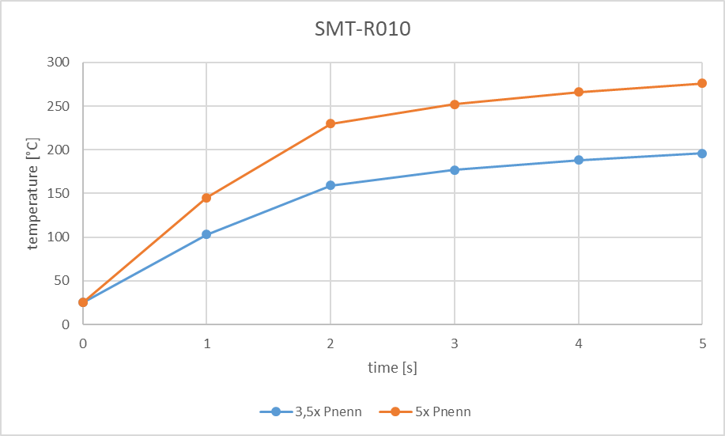
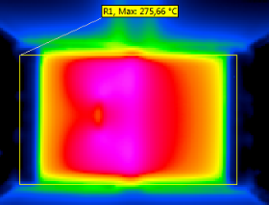

Space Testing
Mitbewerber
Temperature development over time - Overload compare 3,5x vs. 5x P_{nenn}
IR-picture after 5s at 5x P_{nenn}
∆T after 5s of the different loads: ~ 80 K
IR-picture after 5s at 3,5x P_{nenn}

Slide 8
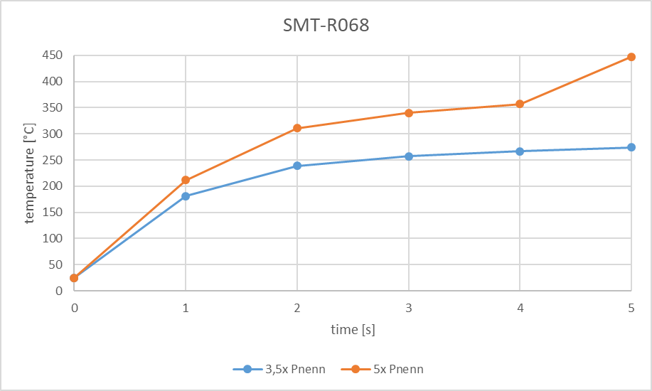
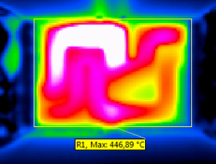
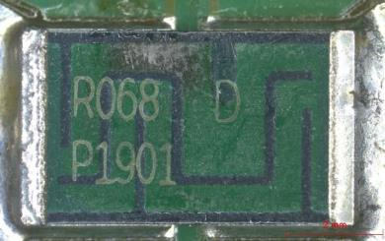
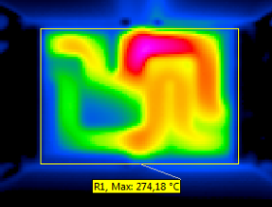
Temperature development over time - Overload compare 3,5x vs. 5x P_{nenn}
Space Testing
Mitbewerber
IR-picture after 5s at 5x P_{nenn}
∆T after 5s of the different loads: ~ 170 K
Temperature rise after 4s indicate a destroyed material/part
IR-picture after 5s at 3,5x P_{nenn}

Slide 9
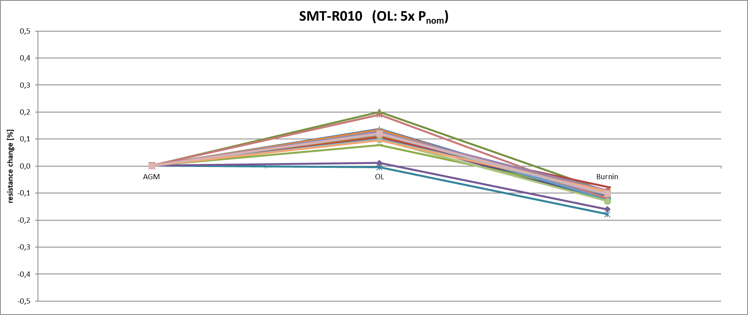

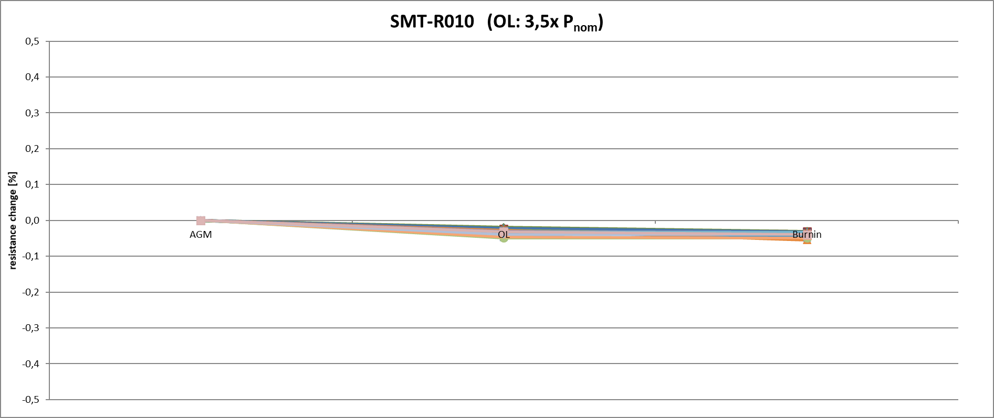

Space Testing
Mitbewerber
OL
BI
Customer specific examination – compare 5x vs. 3,5x P_{nenn}
dR₁/R₀
in %
± 0,3 %
0,11
0,12
0,20
0,11
-0,01
0,11
0,13
0,10
0,08
0,01
0,13
0,13
0,13
0,19
0,10
0,12
0,10
0,09
0,12
0,12
dR₁₆₈/R₁
in %
± 0,2 %
-0,22
-0,23
-0,29
-0,23
-0,17
-0,20
-0,25
-0,18
-0,18
-0,17
-0,25
-0,25
-0,25
-0,31
-0,23
-0,21
-0,19
-0,19
-0,22
-0,22
dR₁/R₀
in %
± 0,3 %
-0,02
-0,02
-0,02
-0,03
-0,03
-0,03
-0,02
-0,03
-0,03
-0,03
-0,04
-0,03
-0,05
-0,03
-0,05
-0,03
-0,03
-0,05
-0,04
-0,03
dR₁₆₈/R₁
in %
± 0,2 %
-0,01
-0,01
-0,01
0,00
0,00
-0,01
-0,01
-0,01
-0,01
0,00
-0,01
-0,03
0,00
0,00
0,00
0,00
0,00
0,00
0,00
-0,01

Slide 10
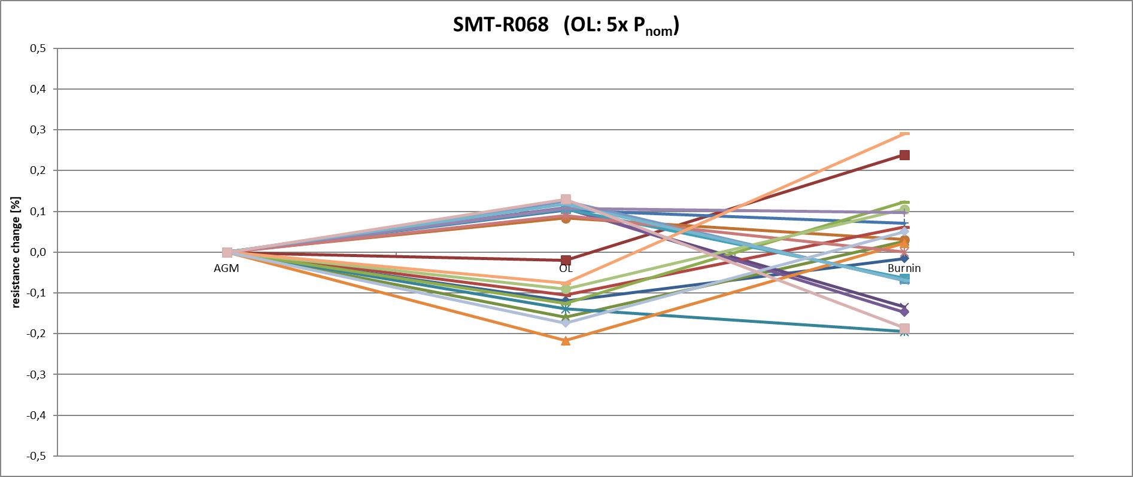
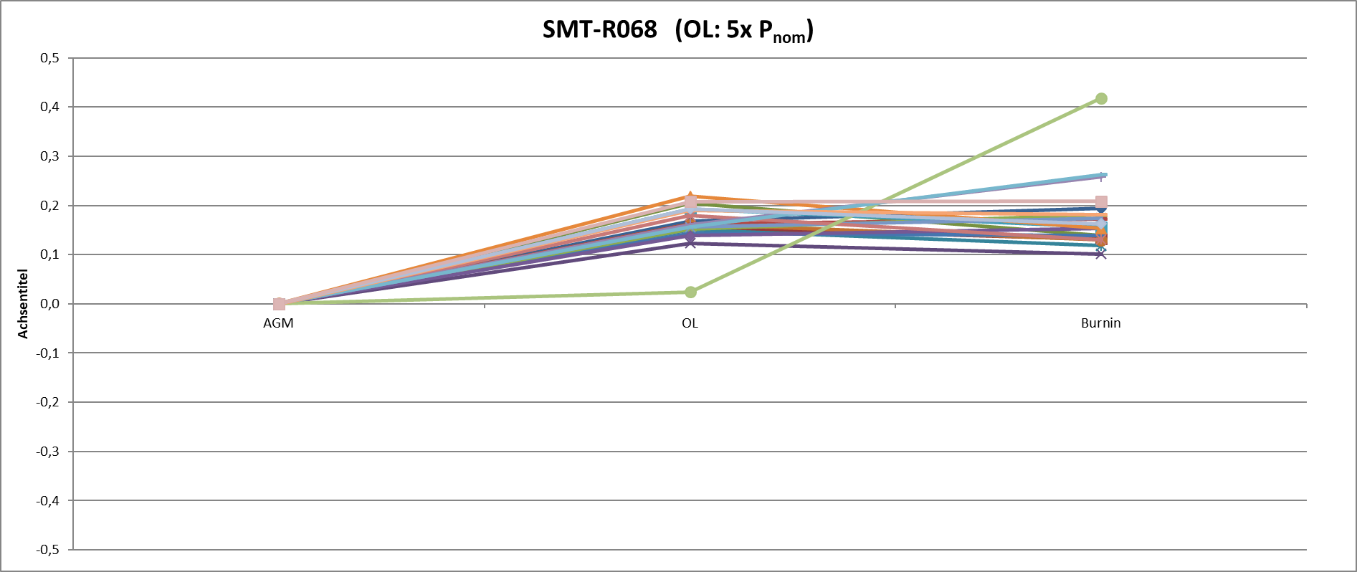
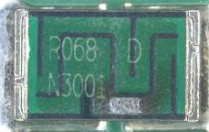

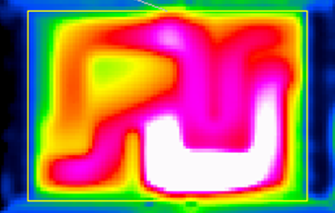
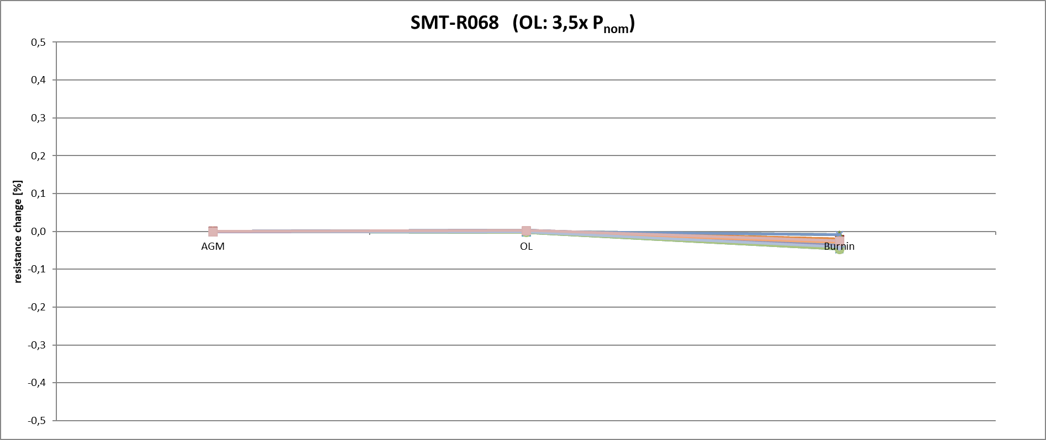

Customer specific examination – compare 5x vs. 3,5x P_{nenn}
Space Testing
Mitbewerber

Slide 11
DCR ESCC 4001/027 Issue 6
5. Summary of specification changes
ESCC 4001/027 |  |  | Issue 6 | Issue 7 (DCR)
Para |  | Headline | Parameter / Tolerance | Parameter / Tolerance
2.1.1.2 | d | Para. 8.3.2, Room Temperature Electrical Measurements | Change in Resistance during Burn-in: ±0.2% max. | Change in Resistance during Burn-in: ±0.3% max.
2.3 |  | Overlaod | Voltage: √(5Pn x Rn) | SMP: Voltage: √(5Pn x Rn)
 |  |  |  | SMS: Voltage: √(3,5Pn x Rn)
 |  |  |  | SMT: Voltage: √(3,5Pn x Rn)
2.6 |  | Operating Life
 |  | Intermediate Measurements (1000 hours) | Change in Resistance: ±0,2% | Change in Resistance: ±0,3%
 |  | Intermediate Measurements (2000 hours) | Change in Resistance: ±0,2% | Change in Resistance: ±0,5%

Slide 12
Thank you for your attention

